Slide 1
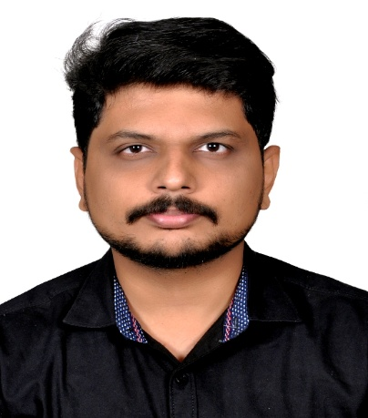





Gowtham Balaji A M
Skills & Competencies
Professional Career
9 years of professional IT experience, including 5 years at Bristlecone and 4 years across multiple organizations, delivering enterprise-grade software solutions.
Delivered technology solutions across diverse industries including Education, MLM, Travel, Retail, Automotive, and enterprise digitization initiatives.
Demonstrated expertise in designing and delivering large-scale, high-availability web applications supporting complex business-critical workflows.
Strong understanding of cloud-based software development life cycles, with hands-on experience across Waterfall, Agile, and Kanban delivery models.
Proven experience in technical project leadership, serving as a client-facing lead, mentoring teams, and translating business requirements into effective technical solutions.
Owned end-to-end project execution, ensuring alignment between scope, timelines, quality, and stakeholder expectations while driving successful delivery outcomes.
Programming & Frameworks: Python, PHP, NodeJS, React / React Native
Databases: MySQL, PostgreSQL, MongoDB
DevOps & Automation: Docker, Ansible
Delivery & Methodologies: Agile / Scrum, SDLC, Performance Optimization
Leadership & Client Engagement: Technical Leadership, Team Mentoring, Stakeholder Management, Client Engagement
Technical Lead
9+ years of professional IT experience with strong expertise in PHP, Python, and NodeJS, and hands-on exposure to React.
Overall, 9 years of Professional IT Experience
4+ years of technical leadership experience, leading teams and engaging directly with clients to deliver business-critical solutions.
Project Experiences
Served as Technical Lead within the ISE team, driving core PHP/Python backend development and end-to-end delivery for KELVIN and RENAISSANCE, while acting as the primary client-facing technical contact.
Led performance optimization initiatives through backend and database query enhancements, significantly improving application responsiveness and stability.
Coordinated cross-functional teams, planned and prioritized deliverables, and mentored engineers through code reviews and best practices to ensure high-quality, on-time delivery.
Designed and implemented a secure Python-based Kafka pipeline to automate large file processing for THE HINDU content digitization workflows.
Implemented 10+ payment gateway integrations, including cryptocurrency payments with IPN tracking, for MLM platforms.
Developed time-zone–aware Scheduling and POS systems for KSA clients, supporting multi-region business operations.
Built NodeJS RESTful APIs for a large-scale classified platform (AJSquare) and a Python automation tool to generate PDF summaries from database records.
Partnered with business stakeholders to convert functional requirements into technical roadmaps, balancing scope, timelines, and delivery risks.
Provided regular delivery status updates, risk visibility, and mitigation plans to clients and internal stakeholders.
Education & Certification
Education:
Bachelor of Technology (IT).
Certifications/Training:Completed (DevOps- Ansible , Docker, GenAI) Training.​
Industries
gowtham.am@bristlecone.com
Information Technology
Edtech Services
Digitization
Retail
B2B
© 2019 Bristlecone. All rights reserved.
1

